Slide 1
Chapter 22 – Database: SQL, MySQL, DBI and ADO.NET
Outline
22.1 Introduction
22.2 Relational Database Model
22.3 Relational Database Overview: Books.mdb Database
22.4 SQL (Structured Query Language)
22.4.1 Basic SELECT Query
22.4.2 WHERE Clause
22.4.3 ORDER BY Clause
22.4.4 Merging Data from Multiple Tables: INNER JOIN
22.4.5 Joining Data from Tables Authors, AuthorISBN, Titles and Publishers
22.4.6 INSERT Statement
22.4.7 UPDATE Statement
22.4.8 DELETE Statement

Slide 2
Chapter 22 – Database: SQL, MySQL, DBI and ADO.NET
22.5 MySQL
22.6 Introduction to DBI
22.6.1 Perl Database Interface
22.6.2 PHP dbx module
22.6.3 Python DB-API
22.7 ADO.NET Object Model
22.8 Web Resources

Slide 3
Objectives
In this lesson, you will learn:
  To understand the relational database model.
  To be able to write database queries using SQL (Structured Query Language).
  To understand the MySQL database server.
  To learn various database interfaces.
  To understand ADO.NET’s object model.

Slide 4
22.1 Introduction
Database
  Integrated collection of data
  Database management system (DBMS)
    Store and organize data consistent with database’s format
    Relational database
      SQL (Structured Query Language)
        Queries
        Manipulate data

Slide 5
22.2 Relational Database Model
Composed of tables
Row
  Number column
  Primary key
    Reference data in the table
    A column or set of columns in table contains unique data

Slide 6
22.2 Relational Database Model
number
name
department
salary
location
23603
Jones
413
1100
New Jersey
24568
Kerwin
413
2000
New Jersey
Row
34589
Larson
642
1800
Los Angeles
35761
Myers
611
1400
Orlando
47132
Neumann
413
9000
New Jersey
78321
Stephens
611
8500
Orlando
Primary key
Column
Fig. 22.1 Relational database structure of an Employee table.

Slide 7
22.2 Relational Database Model
department
location
413
New Jersey
611
Orlando
642
Los Angeles
Fig. 22.2 Table formed by selecting department and location data from the Employee table.

Slide 8
22.3 Relational Database Overview: Books.mdb Database
Primary key uniquely identifies each row
  Rule of Entity Integrity
Composite primary key
Lines connecting tables
  Relationships
    One-to-many relationship
Foreign key
  Join multiple tables
  Rule of Referential Integrity

Slide 9
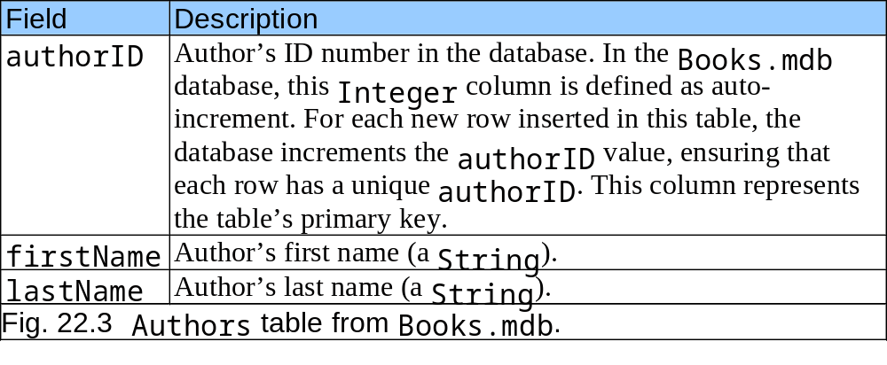
22.3 Relational Database Overview: Books.mdb Database

Slide 10
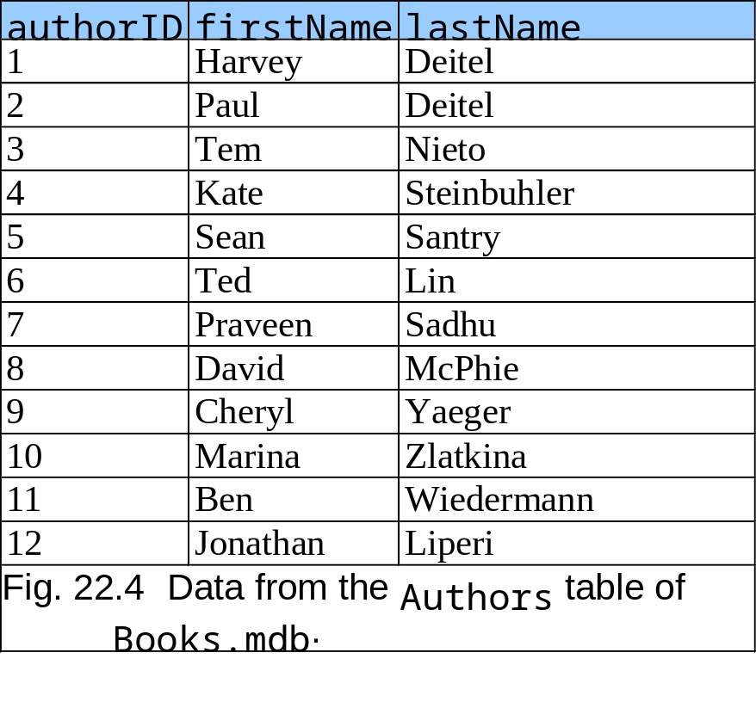
22.3 Relational Database Overview: Books.mdb Database

Slide 11
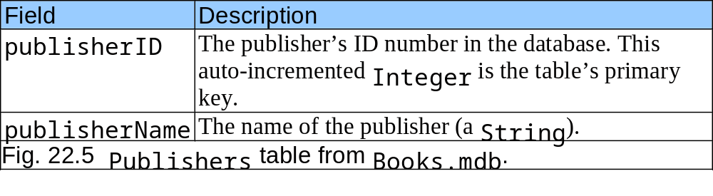
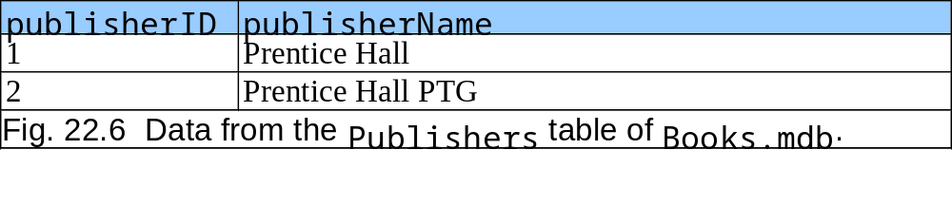
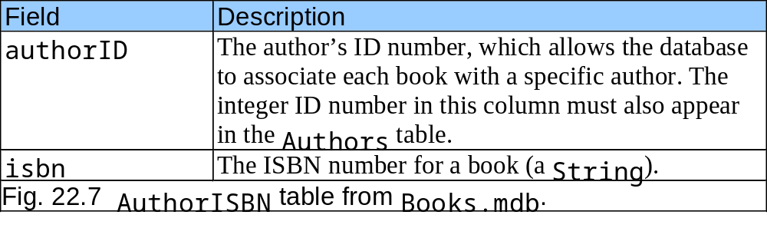
22.3 Relational Database Overview: Books.mdb Database

Slide 12
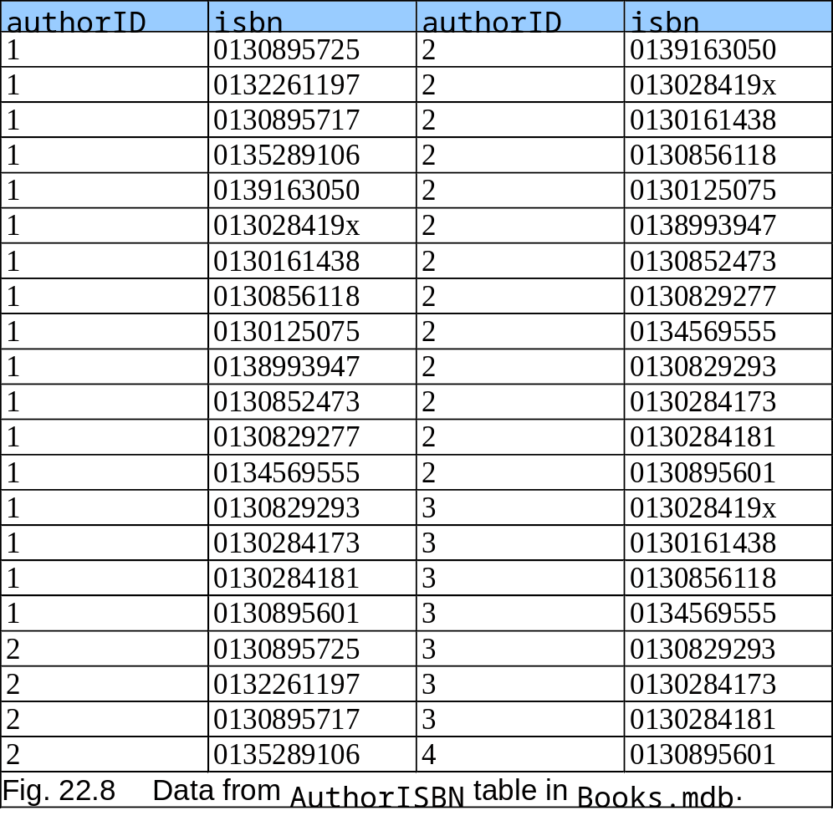
22.3 Relational Database Overview: Books.mdb Database

Slide 13
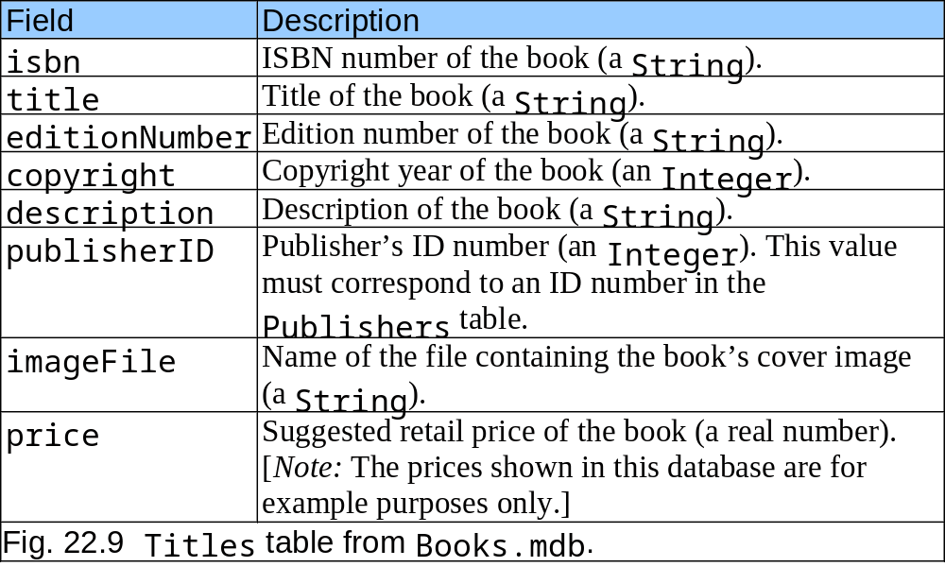
22.3 Relational Database Overview: Books.mdb Database

Slide 14
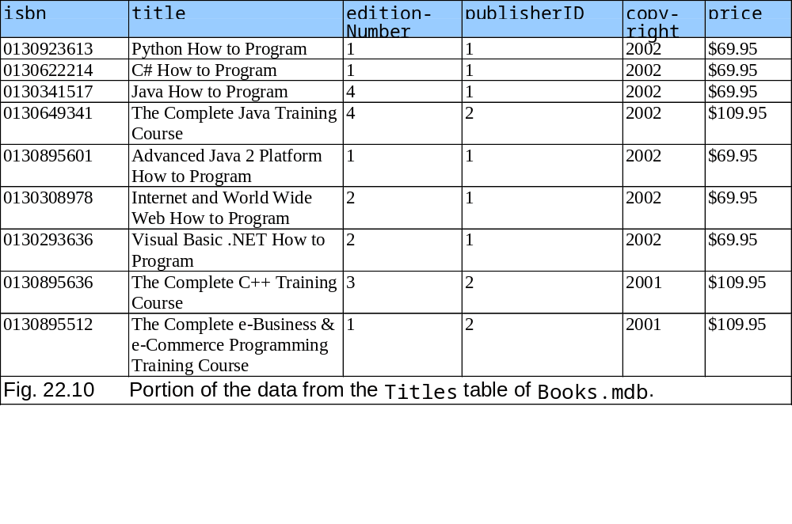
22.3 Relational Database Overview: Books.mdb Database

Slide 15
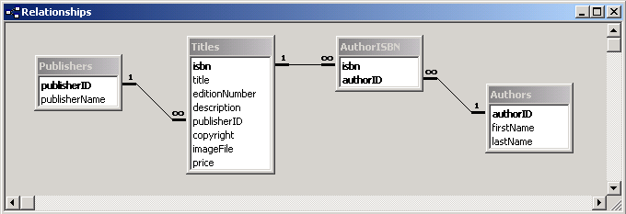
22.3 Relational Database Overview: Books.mdb Database
Fig. 22.11 Table relationships in Books.mdb.

Slide 16
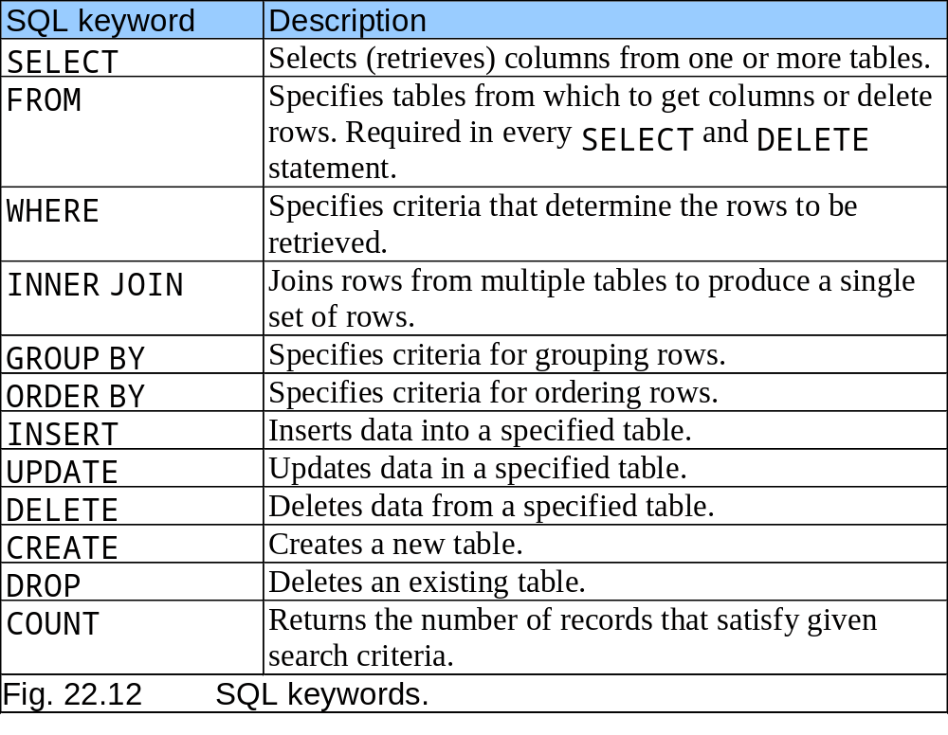
22.4 SQL (Structured Query Language)

Slide 17
22.4.1 Basic SELECT Query
SELECT * FROM tableName
  SELECT * FROM Authors
  SELECT authorID, lastName FROM Authors

Slide 18
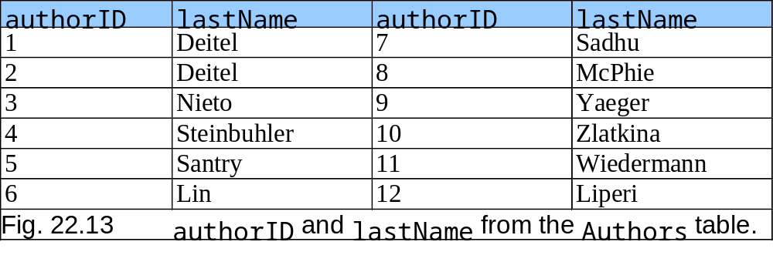
22.4.1 Basic SELECT Query

Slide 19
22.4.2 WHERE Clause
Specify selection criteria for query
  SELECT columnName1, columnName2, … FROM tableName WHERE criteria
    SELECT title, editionNumber, copyright FROM Titles WHERE copyright > 1999
  LIKE
    Pattern matching
      Asterisk ( * )
        SELECT authorID, firstName, lastName FROM Authors WHERE lastName LIKE ‘D*’
      Question mark ( ? )
        SELECT authorID, firstName, lastName FROM Authors WHERE lastName LIKE ‘?I*’

Slide 20
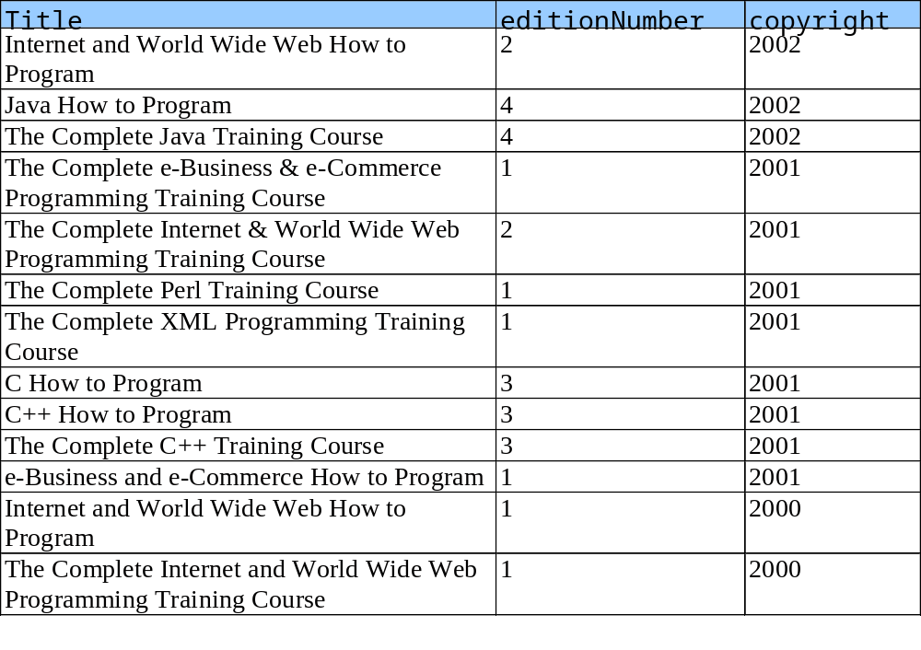
22.4.2 WHERE Clause

Slide 21
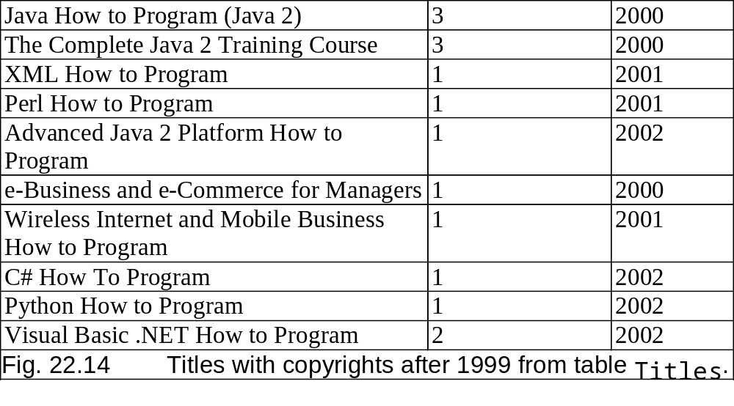
22.4.2 WHERE Clause

Slide 22
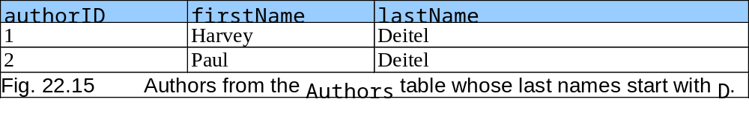
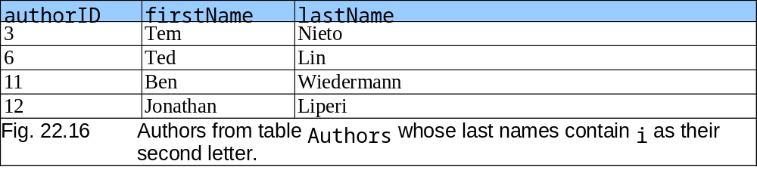
22.4.2 WHERE Clause

Slide 23
22.4.3 ORDER BY Clause
Arranged in ascending or descending order
  SELECT columnName1, columnName2, … FROM tableName ORDER BY column ASC
    SELECT authorID, firstName, lastName FROM Authors ORDER BY lastName ASC
  SELECT columnName1, columnName2, … FROM tableName ORDER BY column DESC
    SELECT authorID, firstName, lastName FROM Authors ORDER BY lastName DESC

Slide 24
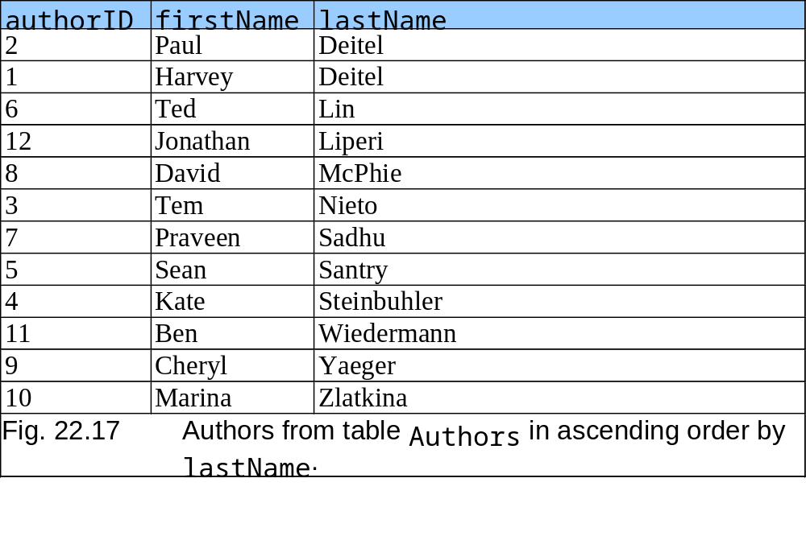
22.4.3 ORDER BY Clause

Slide 25
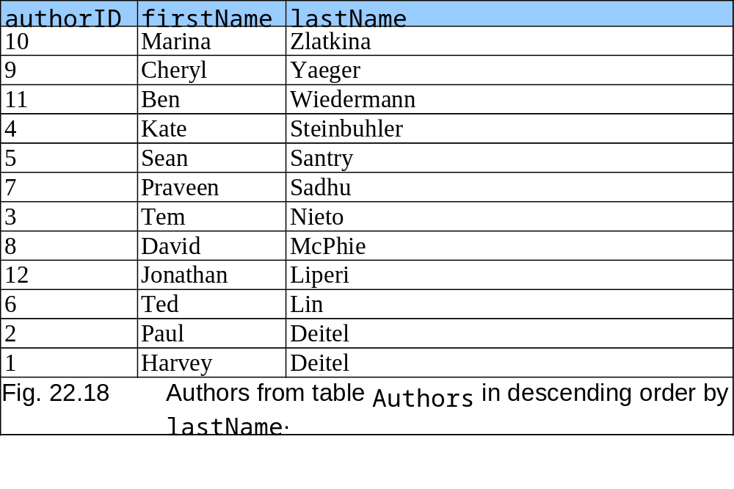
22.4.3 ORDER BY Clause

Slide 26
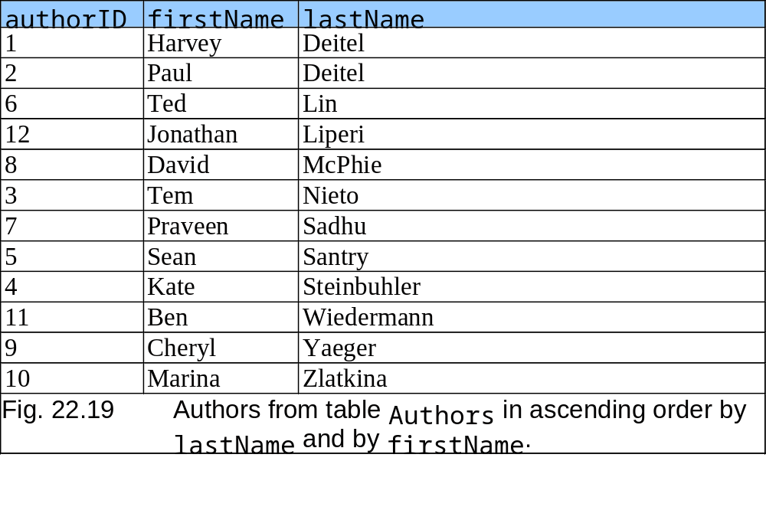
22.4.3 ORDER BY Clause

Slide 27
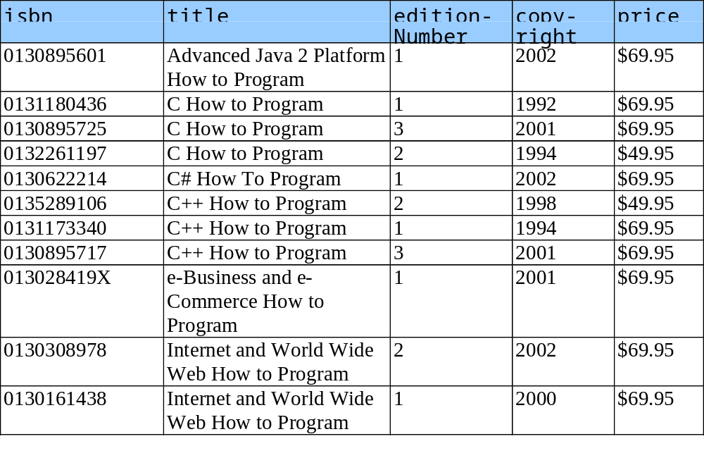
22.4.3 ORDER BY Clause

Slide 28
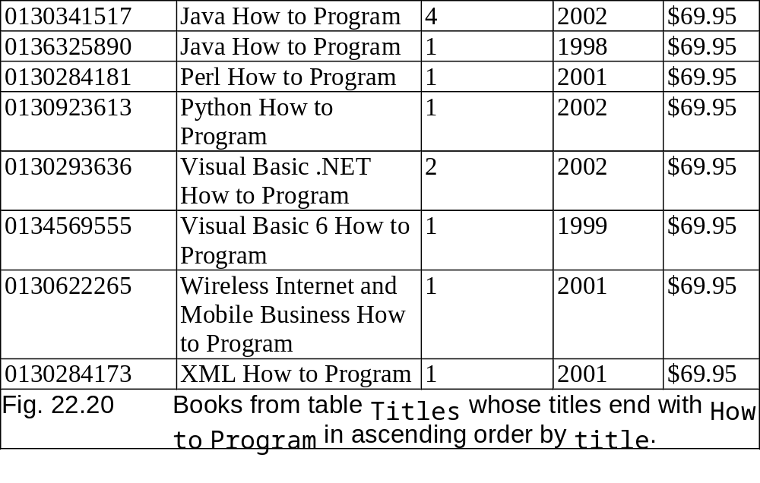
22.4.3 ORDER BY Clause

Slide 29
22.4.4 Merging Data from Multiple Tables: INNER JOIN
Normalize databases
  Ensure database does not store data redundantly
  SELECT columnName1, columnName2, … FROM table1 INNER JOIN table2 ON table1, columnName = table2.columnName

Slide 30
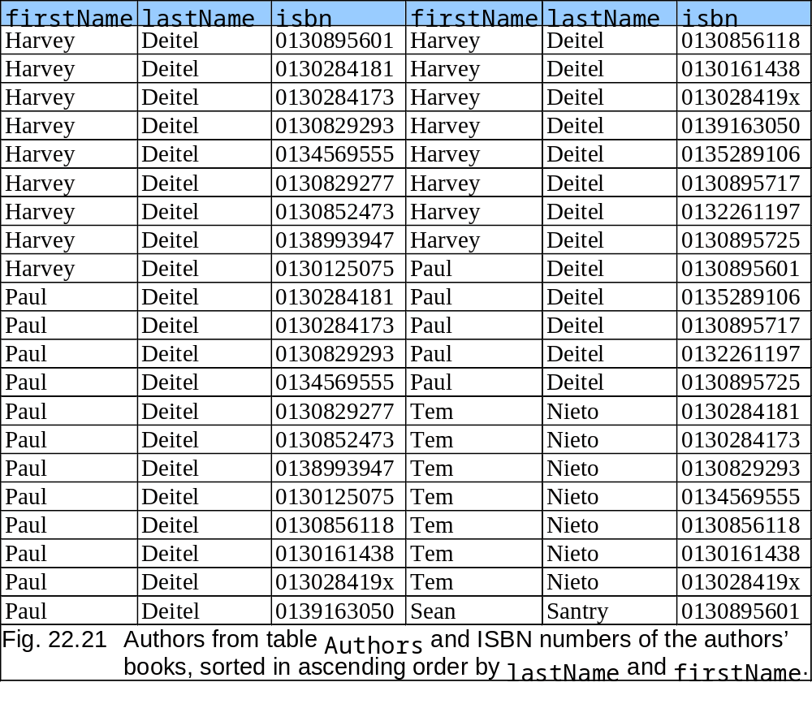
22.4.4 Merging Data from Multiple Tables: INNER JOIN

Slide 31
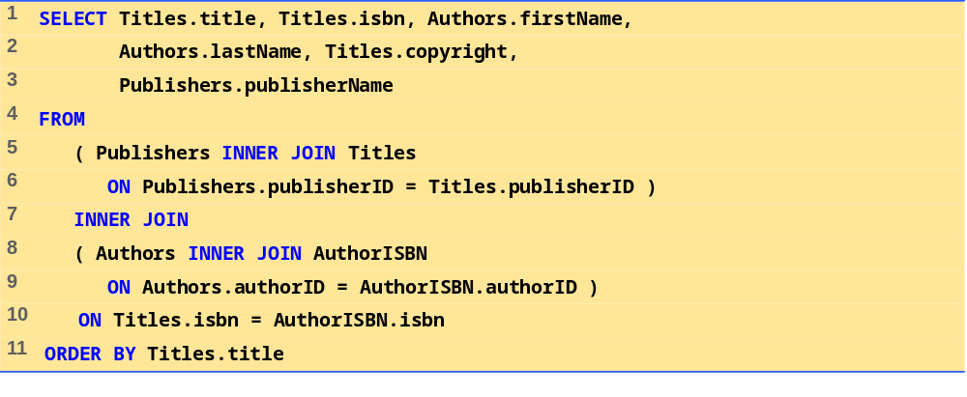
Fig. 22.22
(1 of 1)

Slide 32
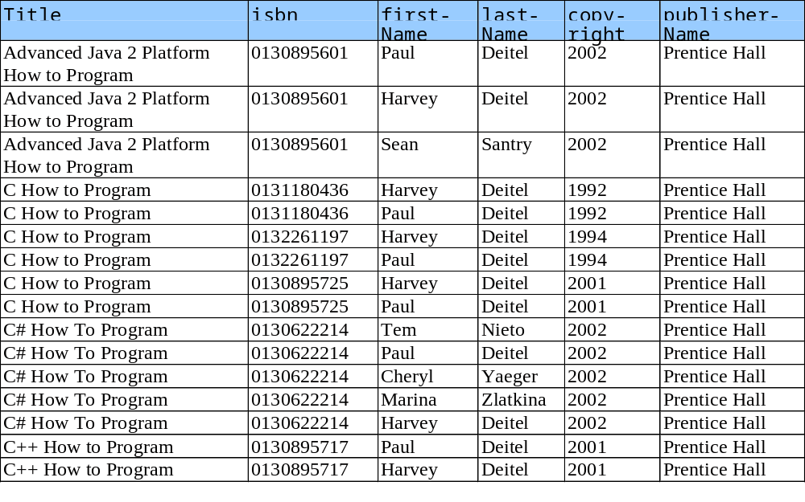
22.4.5 Joining Data from Tables Authors, AuthorISBN, Titles and Publishers

Slide 33
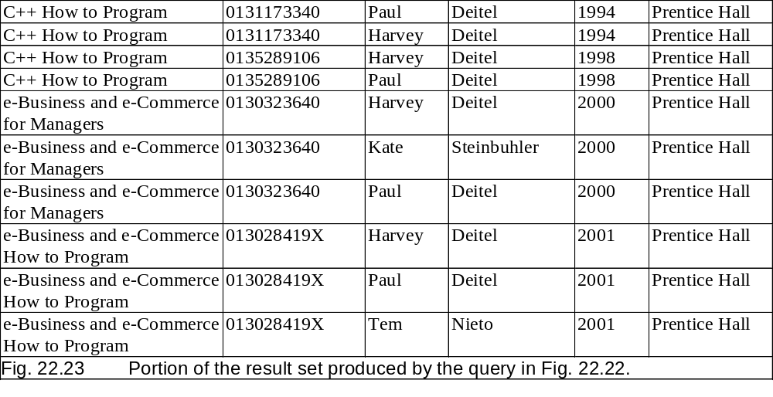
22.4.5 Joining Data from Tables Authors, AuthorISBN, Titles and Publishers

Slide 34
22.4.6 INSERT Statement
Inserts new row in table
  INSERT INTO tableName ( columnName1, columnName2, …, columnNameN ) VALUES ( value1 , value2, …, valueN )

Slide 35
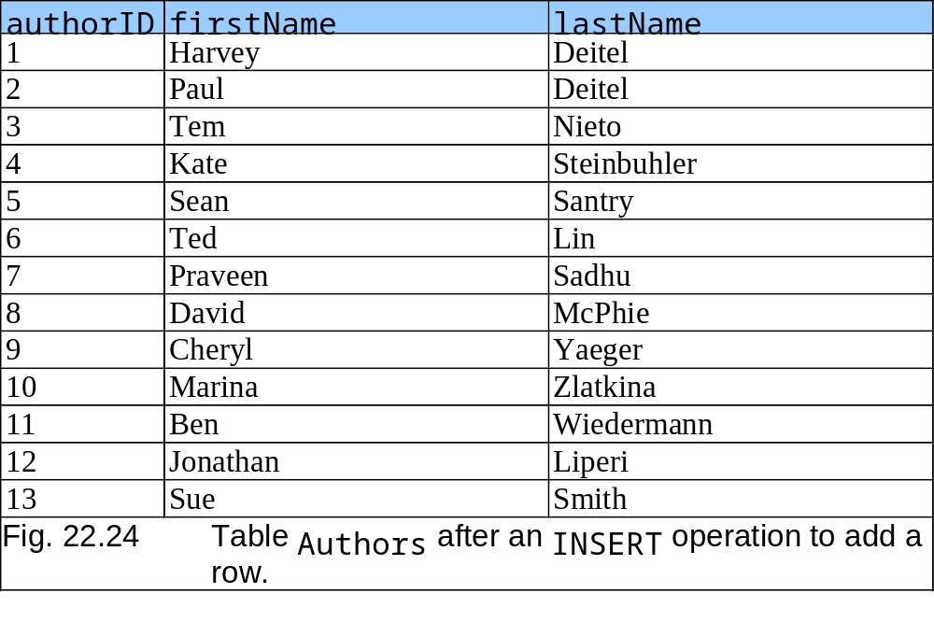
22.4.6 INSERT Statement

Slide 36
22.4.7 UPDATE Statement
Modifies data in a table
  UPDATE tableName SET columnName1 = value1, columnName2 = value2, …, columnNameN = valueN WHERE criteria

Slide 37
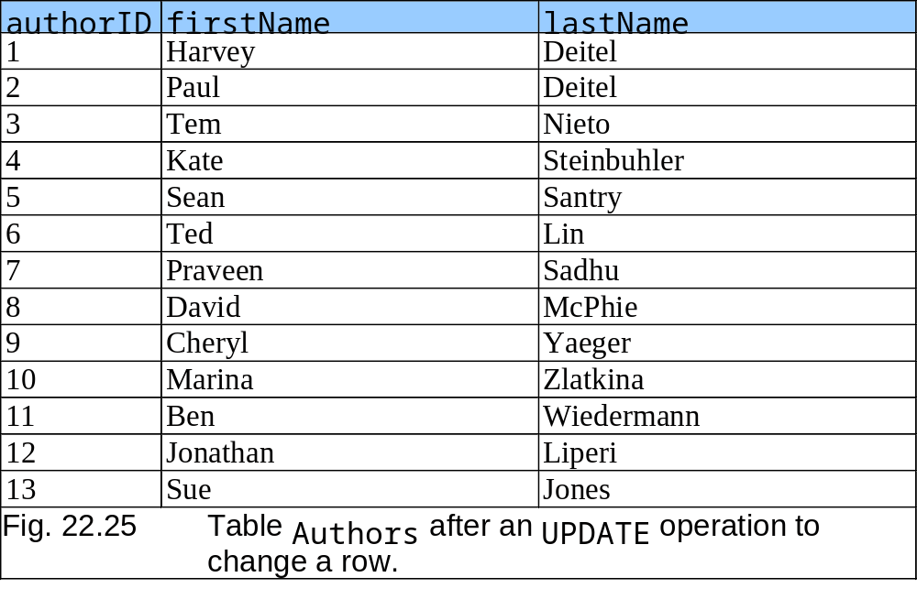
22.4.7 UPDATE Statement

Slide 38
22.4.8 DELETE Statement
Removes data from a table
  DELETE FROM tableName WHERE criteria

Slide 39
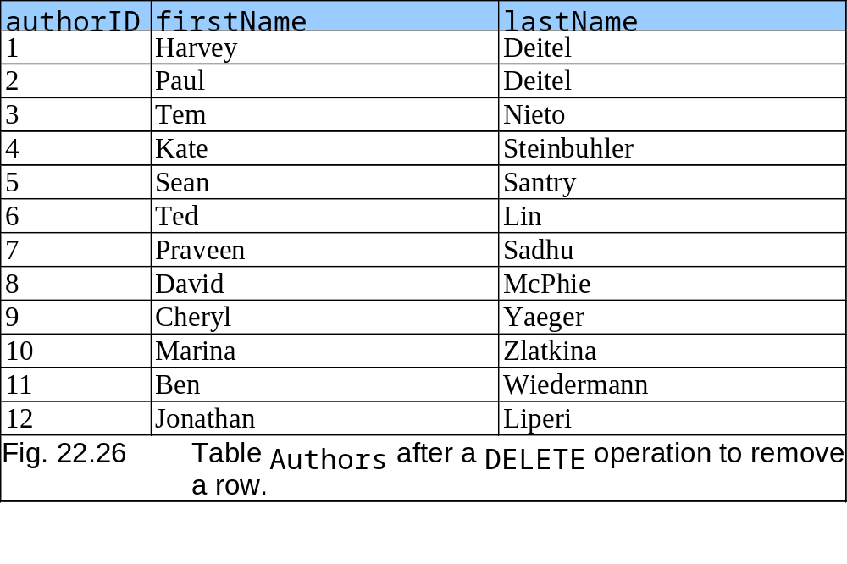
22.4.8 DELETE Statement

Slide 40
22.5 MySQL
Multi-user and multi-threaded RDBMS server
Uses SQL to interact with and manipulate data
Supports various programming languages
Access tables from different databases
Handle large databases

Slide 41
22.6 Introduction to DBI
Uniform access to all database systems
Access relational databases

Slide 42
22.6.1 Perl Database Interface
Access relational databases from Perl programs
Database independent
Handles
  Driver handles
  Database handles
  Statement handles

Slide 43
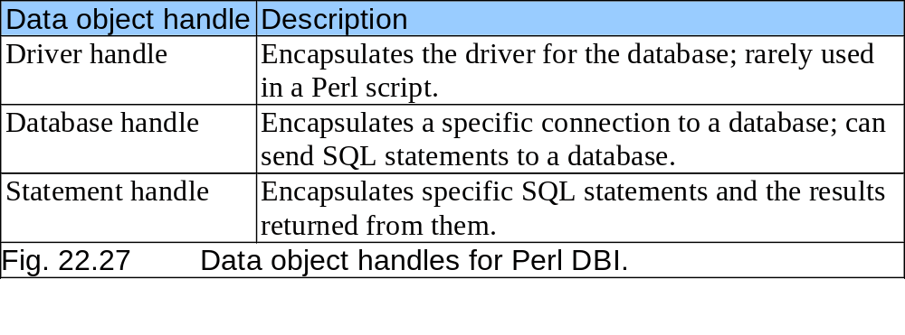
22.6.1 Perl Database Interface

Slide 44
22.6.2 PHP dbx module
Seven functions that interface to database modules
MySQL
PostgreSQL
Microsoft SQL Server
Oracle
Sybase
FrontBase
ODBC (Open Database Connectivity)

Slide 45
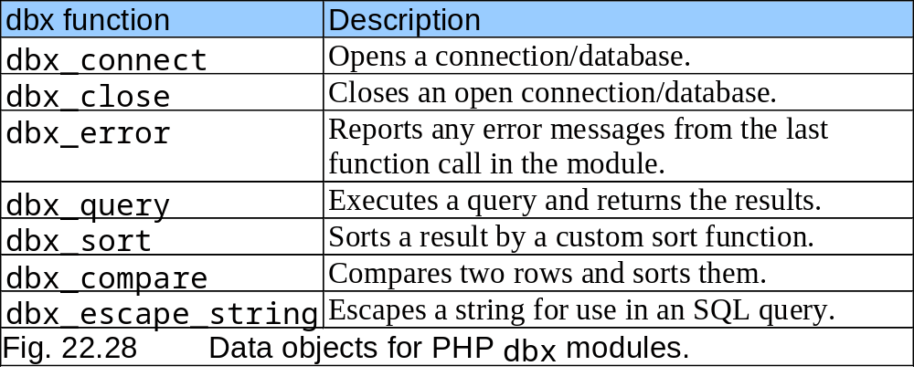
22.6.2 PHP dbx module

Slide 46
22.6.3 Python DB-API
Consists of Connection data objects and Cursor data objects
Portable across several databases

Slide 47
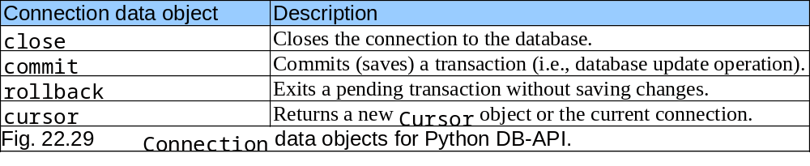
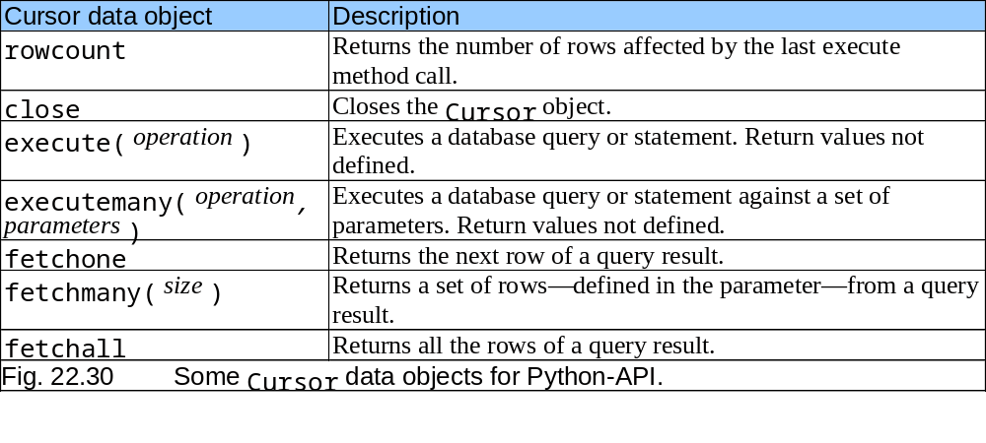
22.6.3 Python DB-API

Slide 48
22.7 ADO.NET Object Model
API
  Access database systems programmatically
  Created for the .NET framework
  Primary namespaces
    System.Data
    System.Data.OleDb
    System.Data.SqlClient

Slide 49
22.8 Web Resources
www.sql.org
www.mysql.com
www.microsoft.com/sql
www.microsoft.com/sql/downloads/default.asp
www.postgresql.org
www.interbase.com
www.maverick-dbms.org
www.devshed.com
www.cql.com
leap.sourceforge.net
www.voicenet.com/~gray/Home.html
msdn.microsoft.com/library/devprods/vs6/vstudio/mdac200/mdac3sc7.htm
www.w3schools.com/sql
www.sqlmag.com

